Slide 1
CIS8695 Managing Big Data Analytics
Nasim Mousavi
Assistant Professor
J. Mack Robinson College of Business
Georgia State University
nmousavi@gsu.edu

Slide 2
Time Series Analysis
Time series forecasting is performed in nearly every organization that works with quantifiable data
Retail stores use it to forecast sales
Energy companies use it to forecast reserves, production, demand, and prices
Educational institutions use it to forecast enrollment
Governments use it to forecast tax receipts and spending
…

Slide 3
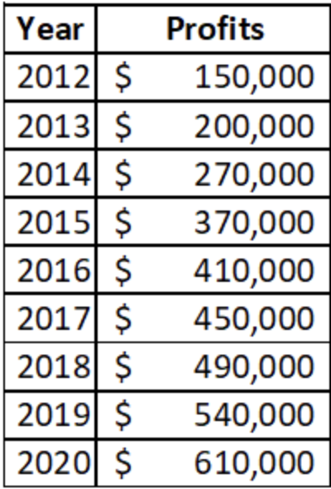
Time Series Analysis
Until now we have dealt with classifying and predicting data where time is not a factor
In the sense that it is not treated differently from other variables, and where the sequence of measurements over time does not matter.
These are typically called cross-sectional data.
We want to learn how to deal with a different type of data: time series

Slide 4
Time Series Analysis
The Main Idea is forecasting future values of a time series
Components of time series:
Level
Average value of the series (intercept in the regression model)
Trend
The change in the series from one period to the next (coefficient in the regression model)
Noise
A random variation that results from measurement error or other causes not accounted for (error in the regression model)
Seasonality
A short-term cyclical behavior of the series

Slide 5
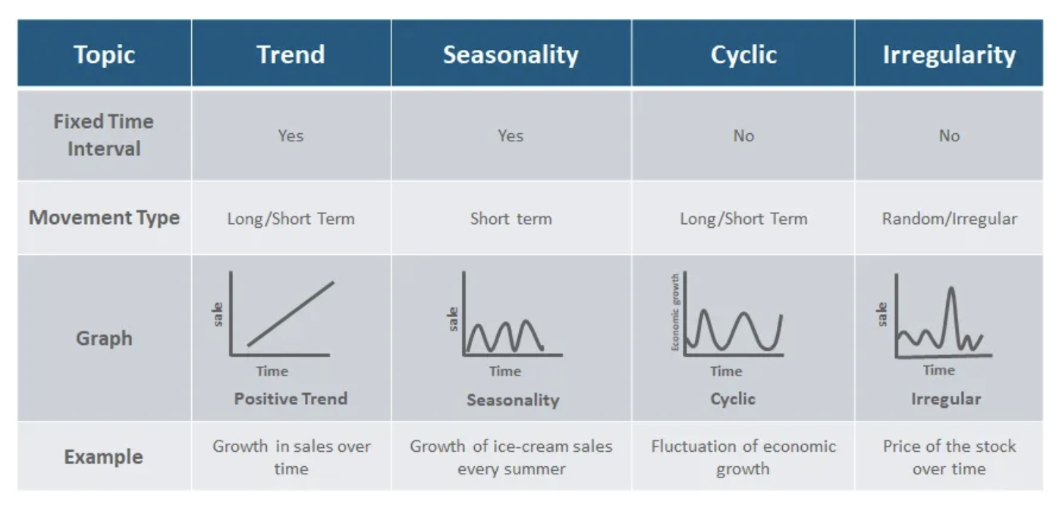
Time Series Analysis

Slide 6
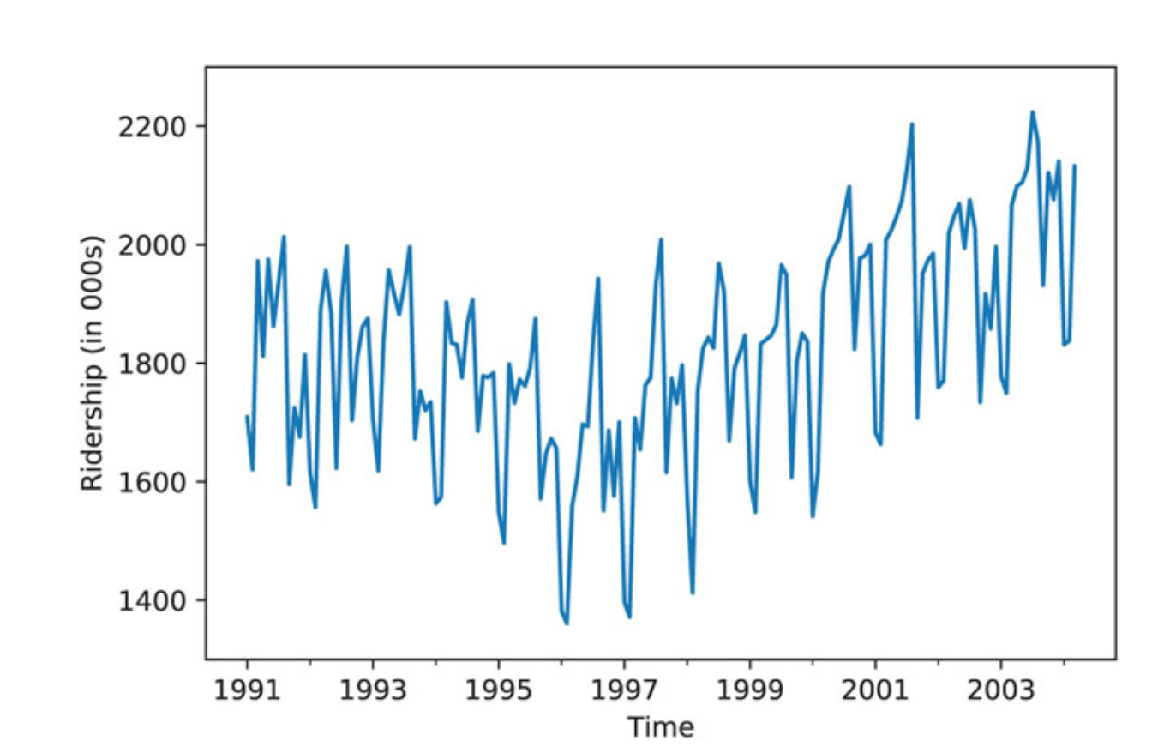
Time Series Plot
In order to identify the components of a time series, the first step is to examine a time plot
In its simplest form, a time plot is a line chart of the series values over time

Slide 7
Partitioning Data and Performance Evaluation
Random partition would create two time series with missing values and the models cannot handle them
The series is trimmed into two periods; the earlier period is set as the training data and the later period as the validation data
Evaluation:
RMSE

